Slide 1
Mobile and Embedded Computing
Lecture 3. Agent assisted coding, Flutter Widgets & UI Elements, Async vs Threads

Slide 2
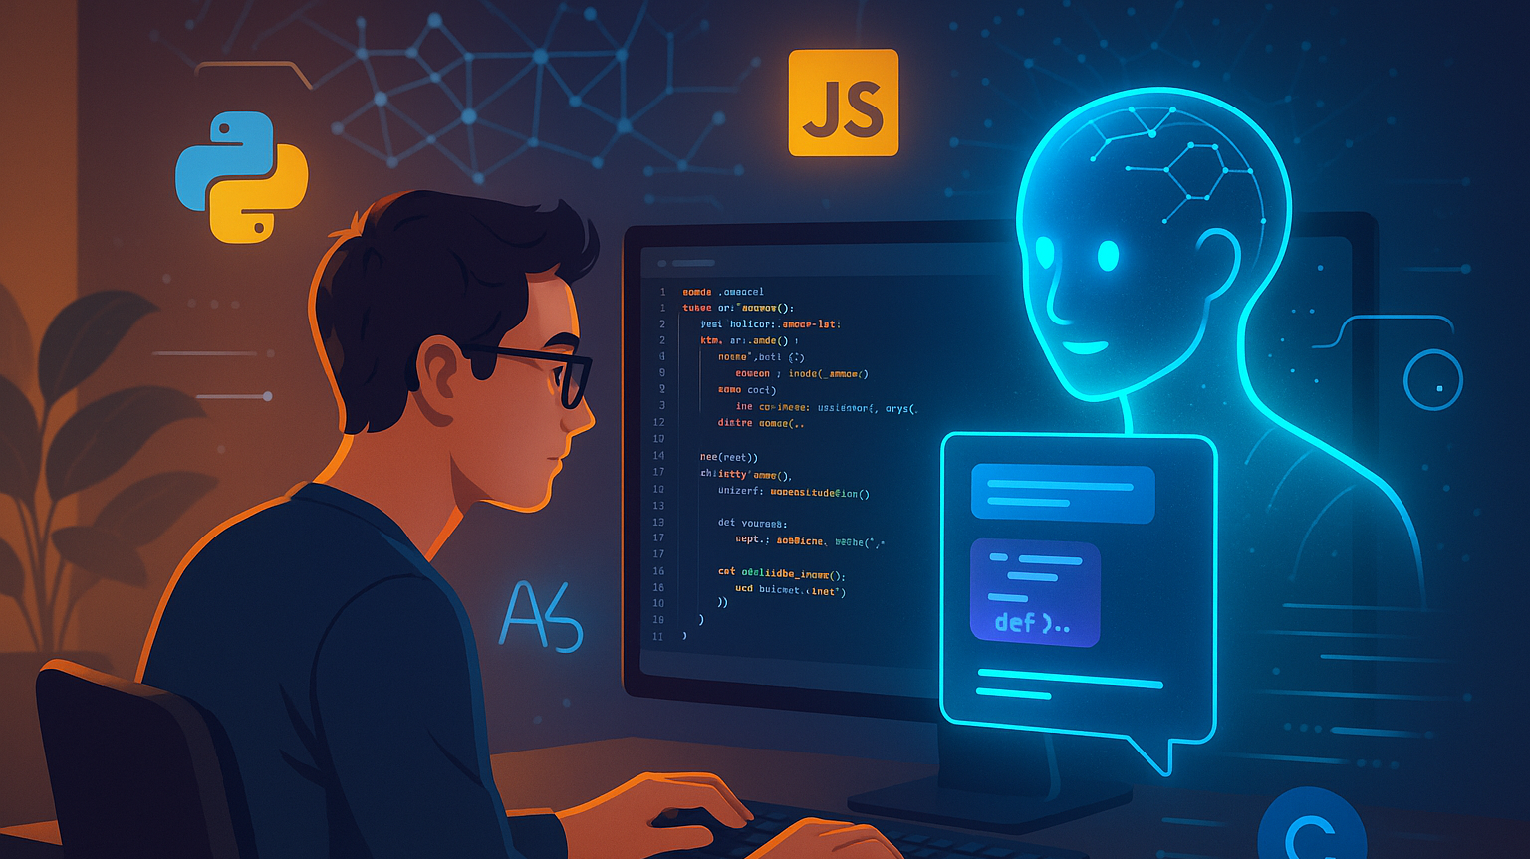
Agent Assisted Coding

Slide 3
Tools
Conversational AI Assistants (Claude, ChatGPT, Gemini)
IDE Integrations (Copilot, Windsurf Plugin, Cline, Roo)
Agentic flow oriented (Cursor, Claude Code, Gemini CLI, Windsurf, Codex, Kiro, JetBrains Junie)

Slide 4
Getting the Most Out of AI
Be specific about context
Share your tech stack, framework versions, and project structure upfront
Explain what you've already tried and what didn't work
Mention any constraints (performance requirements, browser support, dependencies)
Break complex problems into smaller pieces
Instead of "build me a full authentication system," try "help me implement JWT token validation middleware"
You can iterate and build up complexity gradually

Slide 5
Getting the Most Out of AI
Ask for explanations, not just code
Request "explain why this approach works" to actually learn
Ask about trade-offs between different solutions
Understanding the reasoning helps you modify code later
Provide error messages and stack traces
Copy the full error message, not just your interpretation
Include relevant file paths and line numbers
Share the code that's causing the issue

Slide 6
Best Practices
Always review generated code carefully
Don't blindly copy-paste without understanding what it does
Check for security issues (SQL injection, XSS, hardcoded secrets)
Verify it follows your project's conventions and style
Test everything
AI-generated code can have subtle bugs
Write tests or manually verify behavior
Edge cases are often missed

Slide 7
Best Practices
Outdated practices
AI training data has a cutoff, so newer library versions might not be reflected
Always check current documentation for your dependencies
Be skeptical of deprecated methods or patterns
Hallucinated APIs or features
AI might confidently suggest functions or packages that don't exist
Verify that imports, methods, and configuration options are real
Quick check: does it appear in the official docs?
Use MCP servers that are able to give the model latest information

Slide 8
Prompt Engineering
Be Clear and Specific
State exactly what you want rather than what you don't want
Include relevant details, constraints, and requirements upfront
Specify the desired format, length, or structure
Provide Context
Explain the purpose or use case
Share relevant background information
Define your audience or perspective
Use Examples
Show examples of desired outputs (positive examples)
Include counterexamples of what to avoid (negative examples)
Demonstrates patterns more effectively than descriptions alone

Slide 9
Prompt Engineering
Break Down Complex Tasks
Split multi-part requests into clear steps
Use numbered lists for sequential tasks
Ask for step-by-step reasoning when needed
Specify Output Format
Request specific structures (tables, bullet points, code blocks)
Ask for XML tags to organize different sections
Define tone, style, or technical level
Effective Patterns
"Act as a [role]..." for perspective-taking
"Think step-by-step" for reasoning tasks
"Before answering, consider..." for analysis
"Output in [format]" for structured responses

Slide 10
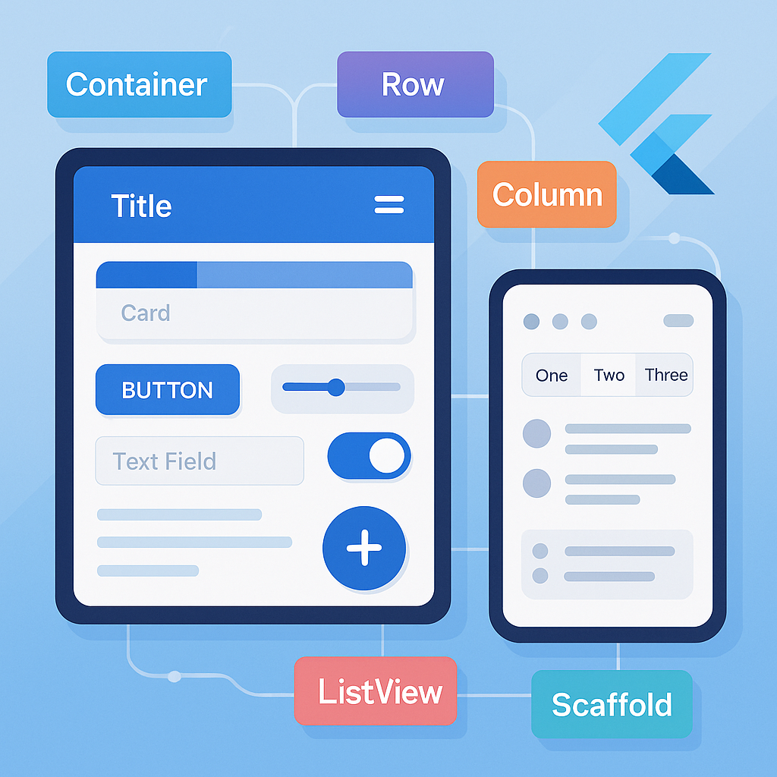
Flutter Widgets and Built in UI elements

Slide 11
Introduction to Widgets - Everything is a Widget in Flutter
In Flutter, widgets are the building blocks of the UI
A widget describes what the view should look like given its current configuration and state
Immutable descriptions of part of the user interface

Slide 12
Widget tree
Flutter apps are structured as a tree of widgets
Parent widgets contain child widgets
Root widget at the top, leaf widgets at the bottom
Example hierarchy: MaterialApp → Scaffold → Column → Text

Slide 13

Paradigm
Declarative UI
Describe WHAT the UI should look like, not HOW to build it
UI = f(state) - UI is a function of state
When state changes, Flutter rebuilds the widget tree
Contrast with imperative approach (Android/iOS traditional)

Slide 14
StatelessWidget vs StatefulWidget
StatelessWidget: Immutable, no internal state that changes
Use when UI doesn't change dynamically
Example: static text, icons, layouts
StatefulWidget: Mutable state that can change over time
Use when UI needs to respond to user interaction or data changes
Contains a State object that persists across rebuilds
Example: forms, animations, real-time data displays

Slide 15
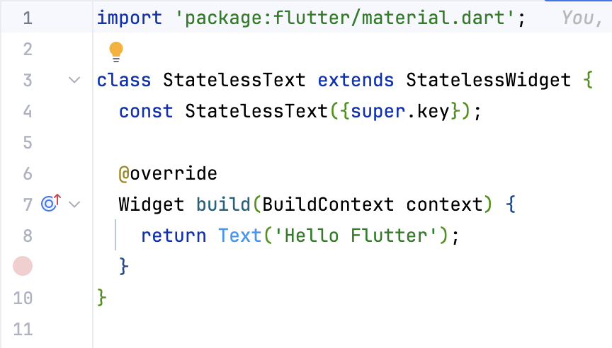
Stateless Widget

Slide 16
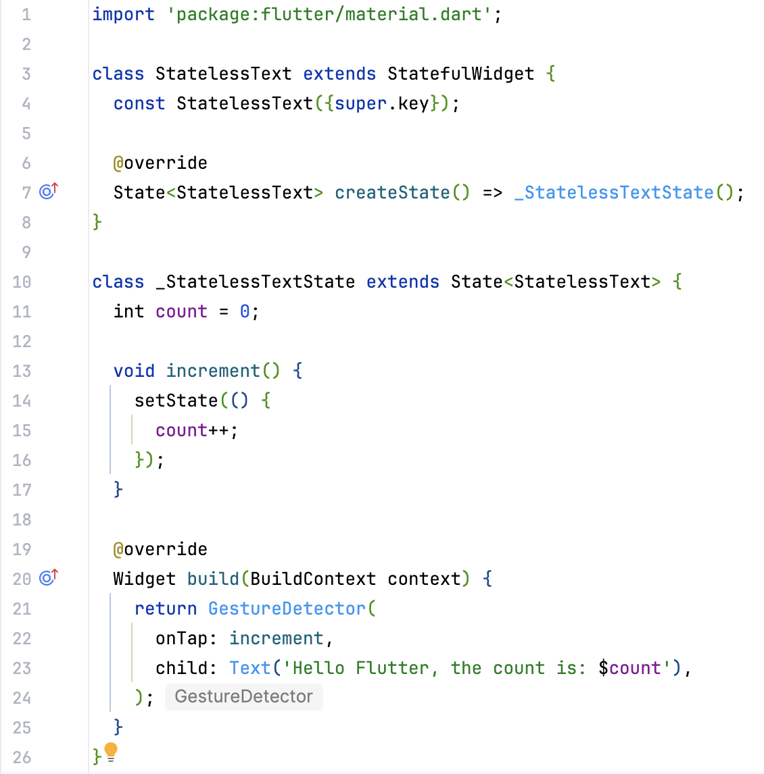
Stateful Widget

Slide 17
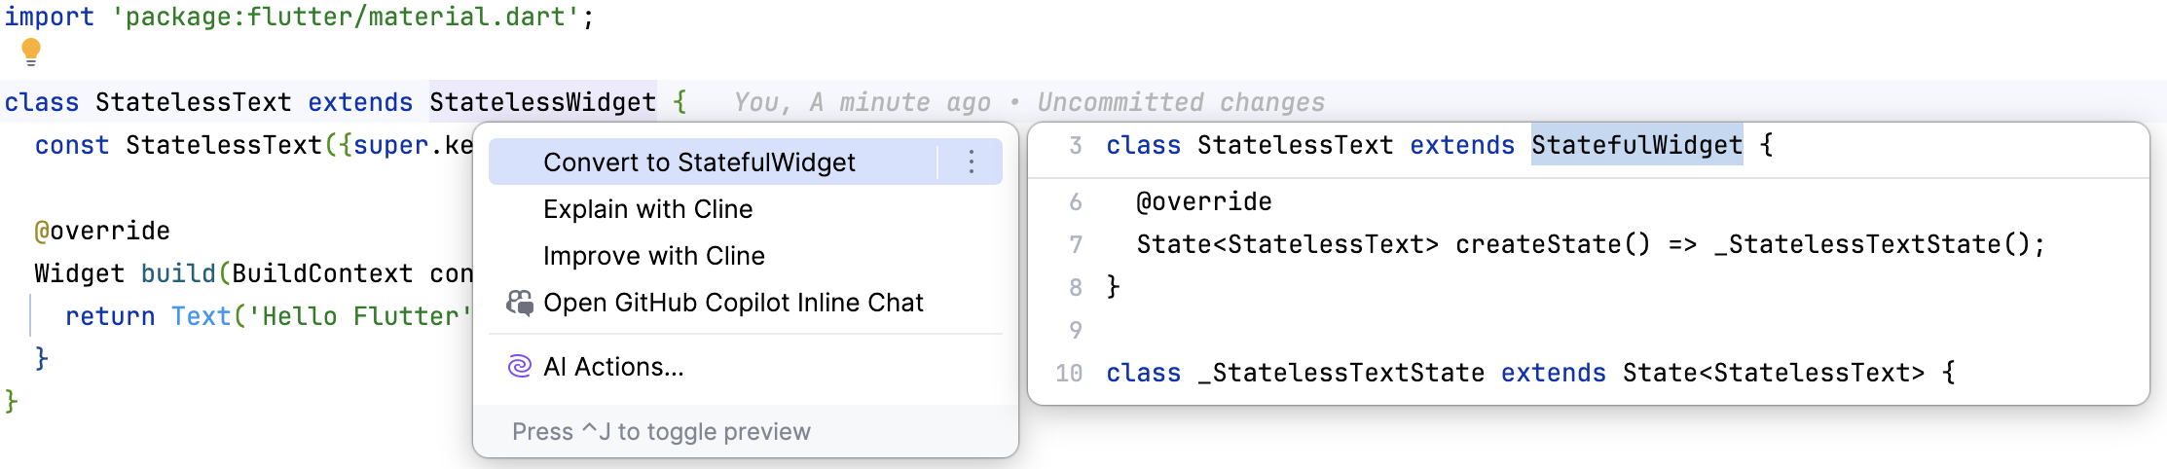
Converting Stateless Widgets to Stateful

Slide 18
Widget Categories – Layout widgets
Purpose: Arrange and position other widgets
Control spacing, alignment, and sizing
Examples:
Container: Single-child layout widget with styling
Row: Horizontal arrangement
Column: Vertical arrangement
Stack: Overlapping widgets

Slide 19
Widget Categories – Structural Widgets
Purpose: Provide app structure and navigation scaffolding
Define the overall architecture
Examples:
Scaffold: Basic material design layout structure
AppBar: Top navigation bar
Drawer: Side navigation menu
BottomNavigationBar: Bottom navigation

Slide 20
Widget Categories – Input Widgets
Purpose: Capture user input
Handle user interactions
Examples:
TextField: Text input
Button variations: ElevatedButton, TextButton
Checkbox, Radio, Switch: Boolean/option selection
Slider: Range selection

Slide 21
Widget Categories – Display Widgets
Purpose: Show content to users
Present information visually
Examples:
Text: Display text
Image: Display images
Icon: Display icons
Card: Material design card

Slide 22

Widget composition
Widgets can be combined to create complex Uis
Small, focused widgets are preferred
Reusability and maintainability through composition
You have the entire Flutter widget catalog here: https://docs.flutter.dev/ui/widgets
see s2_composition good and bad folders for examples

Slide 23
Basic Layout Widgets

Slide 24
Material Design Widgets

Slide 25
Input Widgets

Slide 26
Display Widgets

Slide 27
Scrolling Widgets

Slide 28
Common Widget Properties

Slide 29
Performance optimizations
Use const keyword when widget never changes
Flutter reuses existing widget instance instead of rebuilding
Significant performance improvement
Rule: If widget has no mutable state, make it const

Slide 30
Concurrency

